Slide 1


SmartBite- Online Food Delivery Database Management System
Tool: Microsoft Access (accdb) Type: Company-Level Business Analytics Solution
Designed By: Rajeev tiwari

Slide 2





Slide 3

Business Problem
The Business Challenge
Online food delivery companies handle massive order data, multiple restaurants, varied payment modes, and real-time revenue tracking.
Common challenges:
Unstructured data across months.
Manual reports → Time-consuming.
No customer segmentation.
Error-prone order tracking.
Need: A robust DBMS for sales analysis, revenue tracking, cancellation control, and smart reporting.

Slide 4
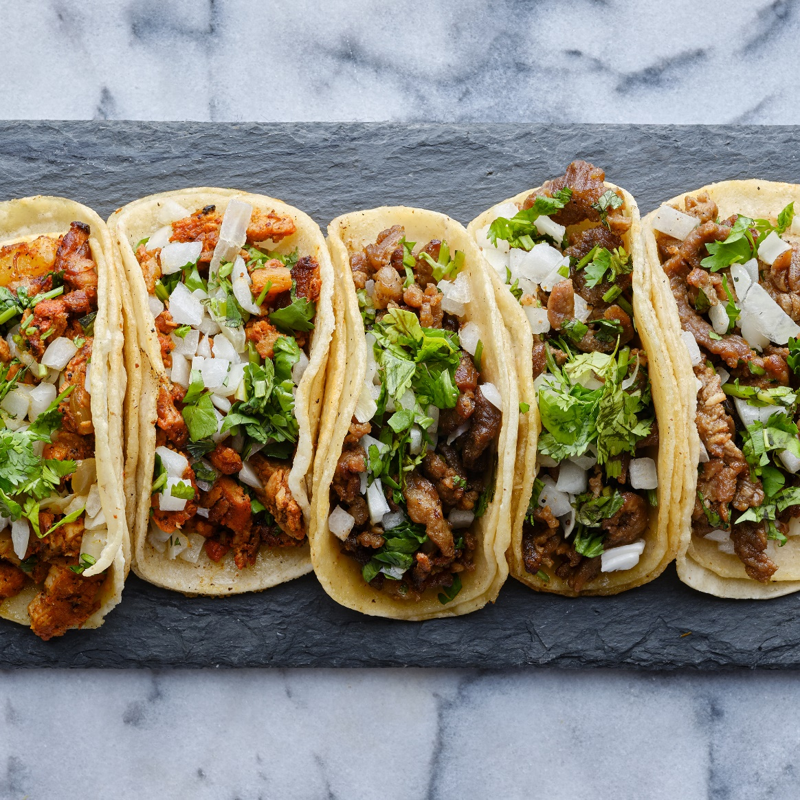
Project Purpose
Why SmartBite?
To design a complete database solution covering:
📦 Food Items & Prices
🍽️ Restaurant Info & Performance
👥 Customer Segmentation
🧾 Monthly Orders & Combined Reports
📊 Real-Time Analytics
To automate Sales, Revenue, Cancellations, Payment Trends, and Reporting.

Slide 5
Final Database Structure
✅ MASTER TABLES:
FoodItems → Item Code, Food Name, Type, Unit Price
Customers → Customer ID, Name, Member Type (Gold/Regular)
Restaurants → Restaurant Code, Name, Type
✅ TRANSACTION TABLES:
Orders_January to Orders_April → Monthly Orders
AllOrders → Merged using Append Queries
✅ RELATIONSHIPS:
Orders ↔️ FoodItems (Many-to-One)
Orders ↔️ Customers (Many-to-One)
Orders ↔️ Restaurants (Many-to-One)
Referential Integrity enforced.

Slide 6
Business Problem Areas Covered
10 Core Business Scenarios:
Sales Analysis — What sells best?
Revenue Calculation — Gross, Net, Discounts
Cancelled Orders — Reasons, % by Food/Restaurant
Customer Segmentation — Member type trends
Restaurant Performance — Revenue & Commission
Monthly Growth Trends — Jan–April
Payment Method Analysis — Cash/Card/UPI share
Master Data Validation — Data entry checks
Data Merge Automation — Append & Union Queries
Forms & Reports — Real-life operations

Slide 7
Insights Unlocked
Example Key Insights
Top 5 selling food items each month.
Gross vs Net Revenue with Gold membership discounts.
Restaurant-wise sales & auto-commission (20%).
Cancellation % — which food/restaurant needs attention.
Loyalty effect: Gold vs Regular customer spending.
Preferred payment methods & their cancellation ratio.
Monthly revenue growth trend: Jan–Apr.

Slide 8
How SmartBite Solves It
Smart Solution Approach
✔️ Crosstab Queries → Monthly trends ✔️ Calculated Fields → Gross/Net Revenue, Discounts ✔️ Group By Queries → Cancellation patterns ✔️ Append & Union Queries → Merging monthly data ✔️ Data Validation Rules → Clean data only ✔️ Macros → Auto-open reports/forms ✔️ Linked Forms → Smooth data entry ✔️ AutoNumber Order IDs → Zero duplication

Slide 9
Final Calculation Fields
Key Calculations Used:
Gross Revenue = Quantity × Unit Price
Discount = 10% for Gold Members
Net Revenue = Gross Revenue – Discount
Commission = Net Revenue × 20%
Cancellation % = Cancelled Orders ÷ Total Orders × 100

Slide 10
Sample Business Questions
✅ Which food item sells the most each month? ✅ Which payment mode has the least cancellations? ✅ What is the revenue difference between Gold & Regular members? ✅ Which restaurant needs performance improvement? ✅ What are the month-wise growth trends?

Slide 11
Final Delivery Plan
Module-wise Deliverables
✔️ Master Tables: FoodItems, Customers, Restaurants ✔️ Transaction Tables: Orders for each month, AllOrders combined ✔️ Forms: New Order Entry, New Customer, New Restaurant, Order Search ✔️ Queries: Sales, Revenue, Cancellations, Segmentation, Payment ✔️ Reports: Visuals — Sales by Restaurant, Payment Pie Chart, Monthly Trends, Customer Loyalty ✔️ Macros & Validation: Auto-filter forms, auto-open reports, data rules

Slide 12
Extras to Make It Real
✔️ Added realistic Unit Prices for items (₹150, ₹250, etc.) ✔️ AutoNumber Order IDs — Avoid duplicate entries ✔️ Macros for auto-opening and filtering reports ✔️ Locked Final Tables — To prevent accidental delete/edit

Slide 13
Conclusion
SmartBite is not just an academic file — it’s a real-company-ready DBMS:
Automates daily food delivery operations.
Generates accurate sales & revenue insights.
Helps management take fast, data-driven decisions.
Completely built with Microsoft Access, using only native tools (Queries, Macros, Forms, Reports).

Slide 14
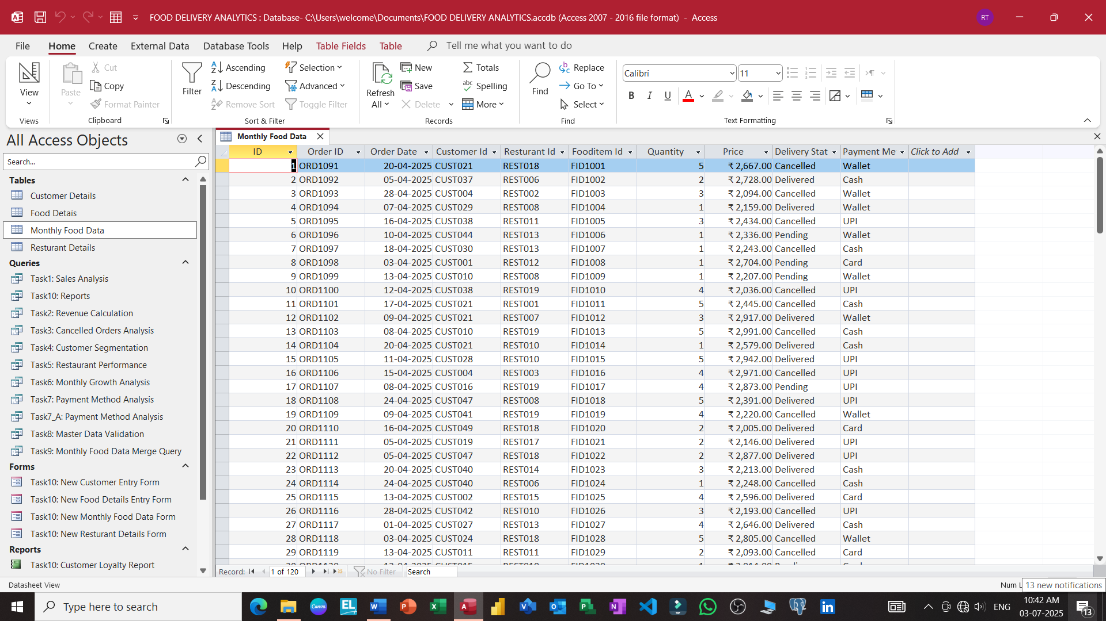

Slide 15
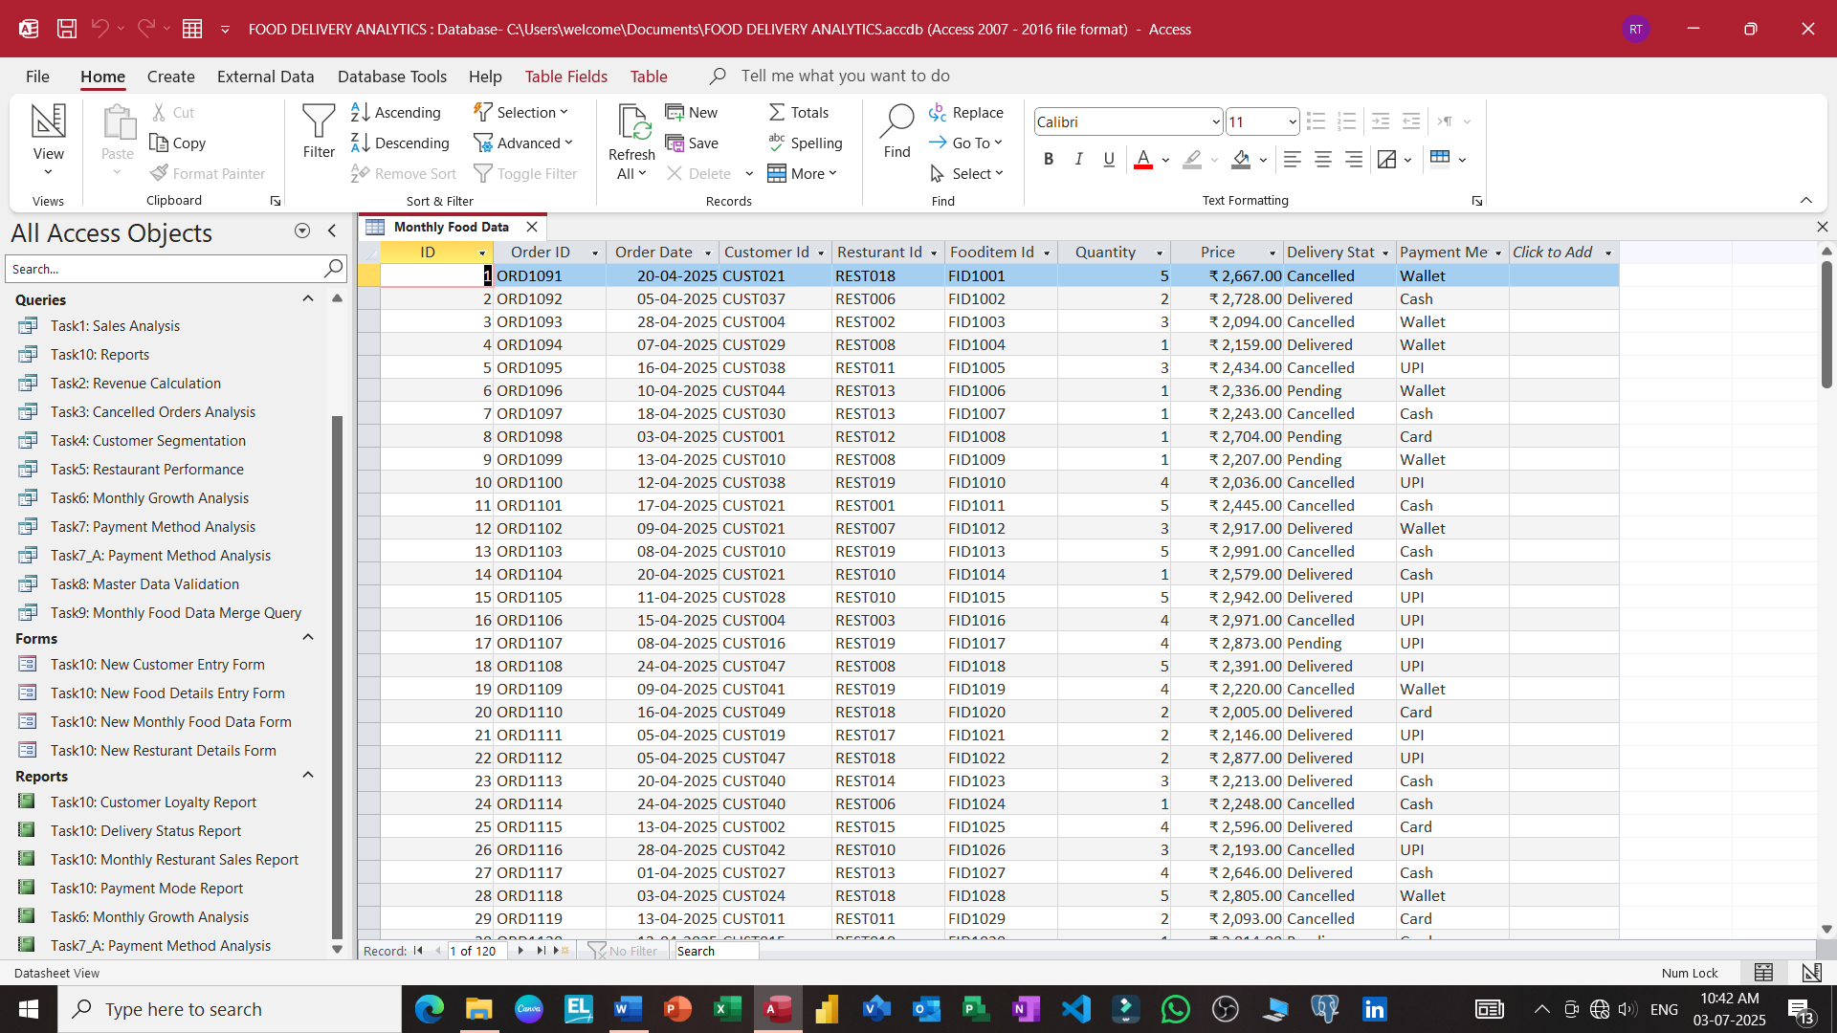

Slide 16
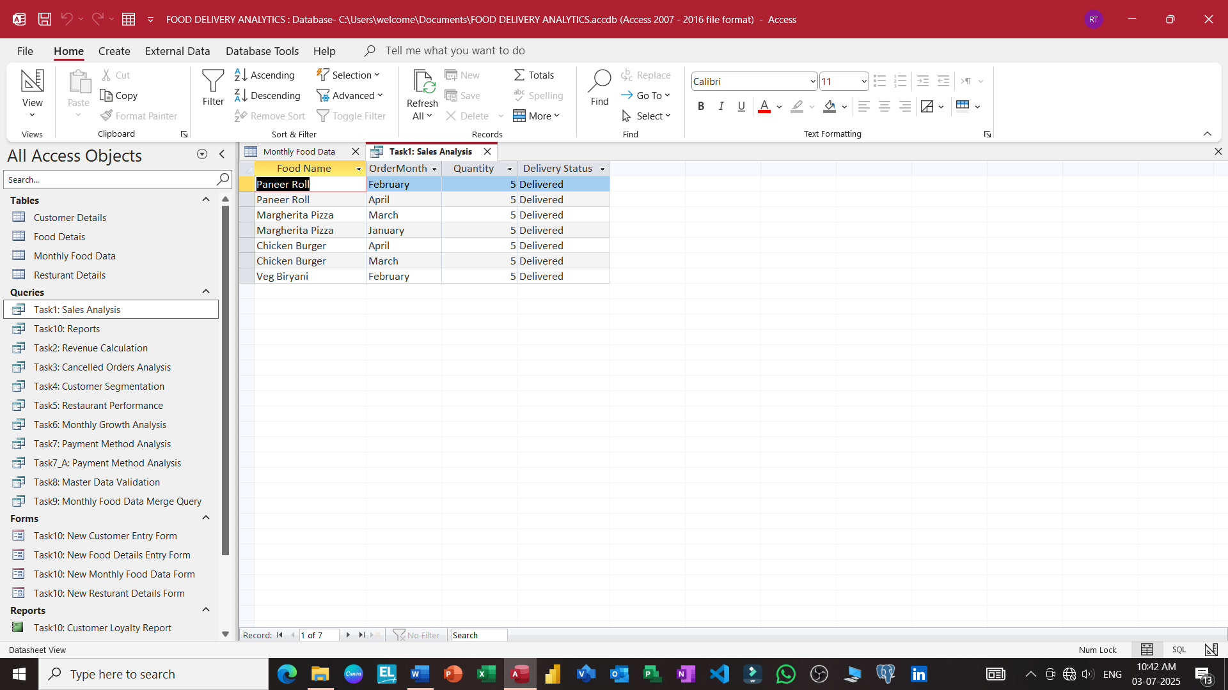

Slide 17
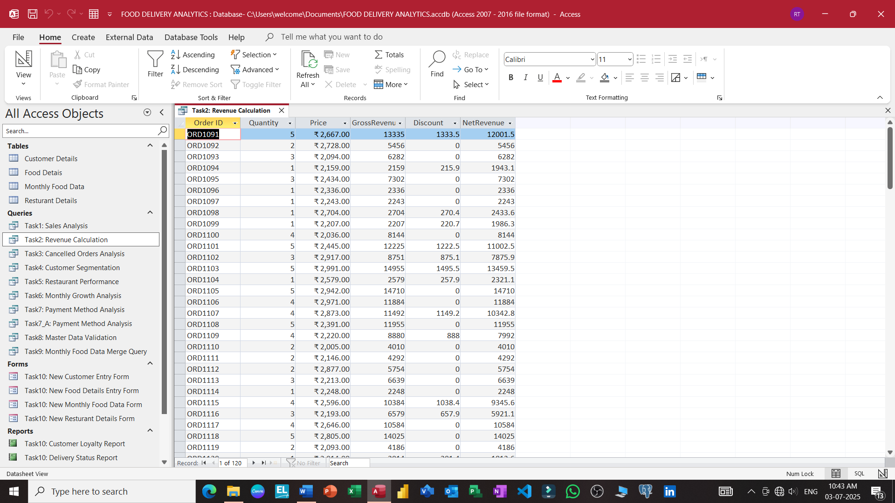

Slide 18
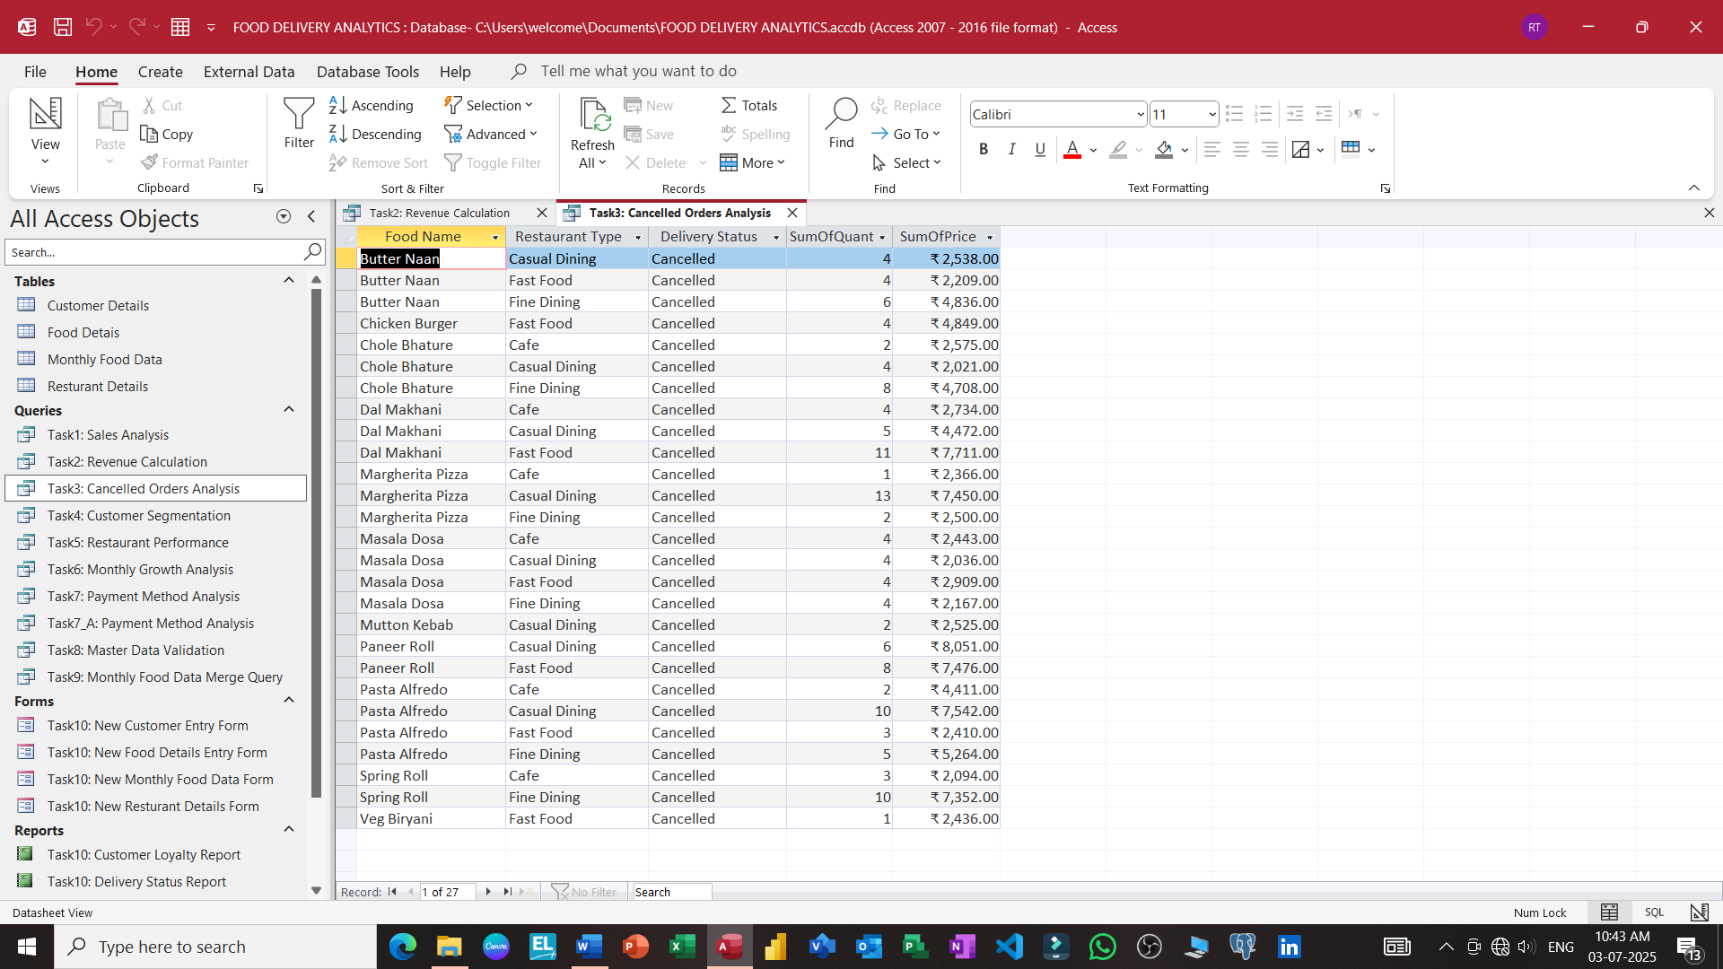

Slide 19
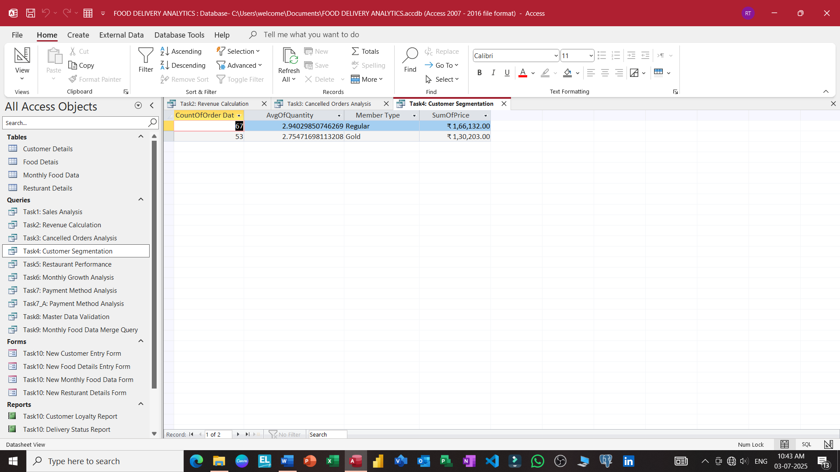

Slide 20
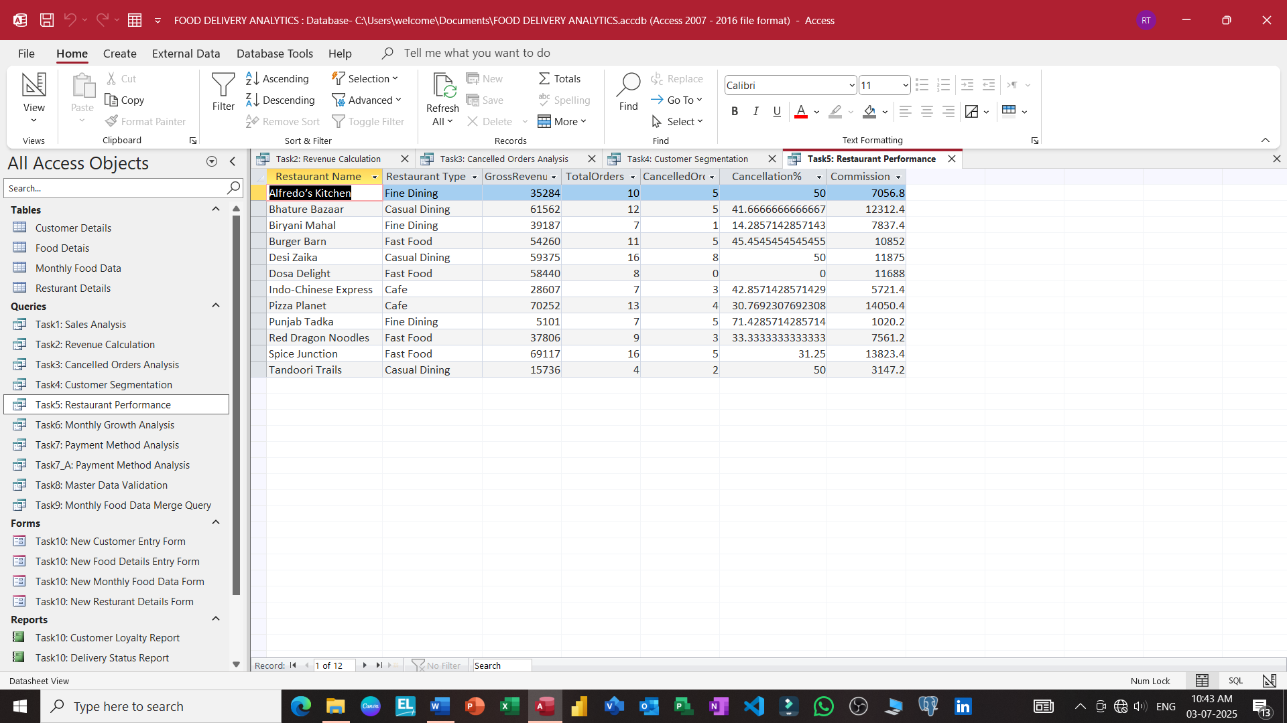

Slide 21
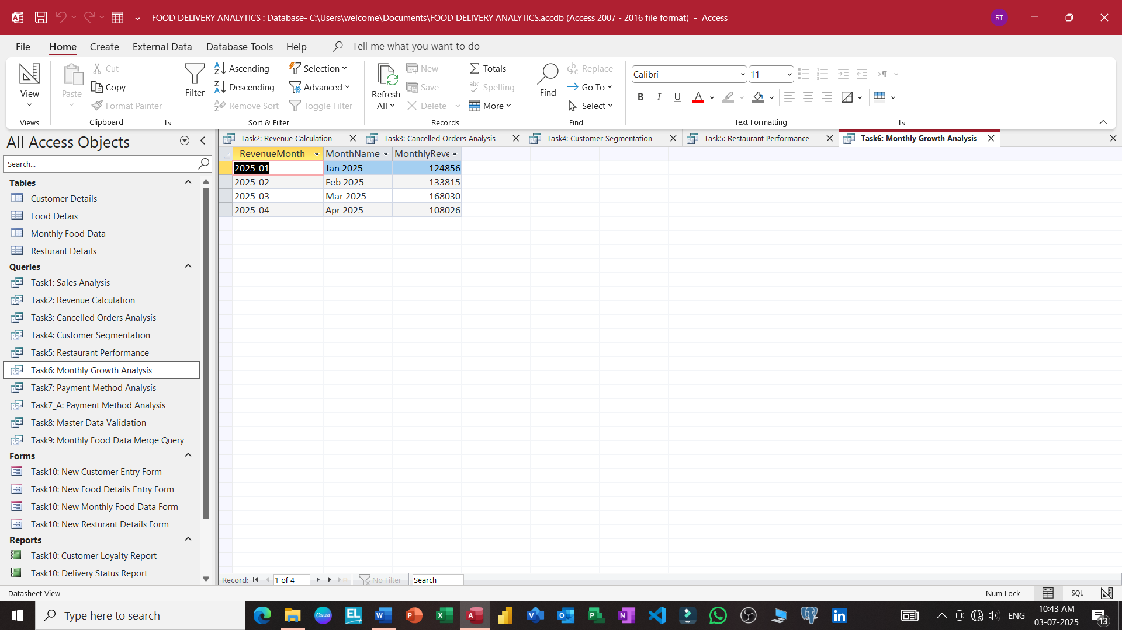

Slide 22
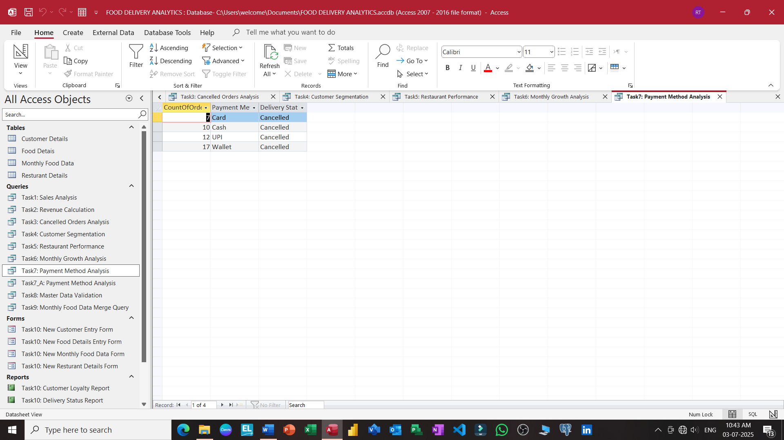

Slide 23
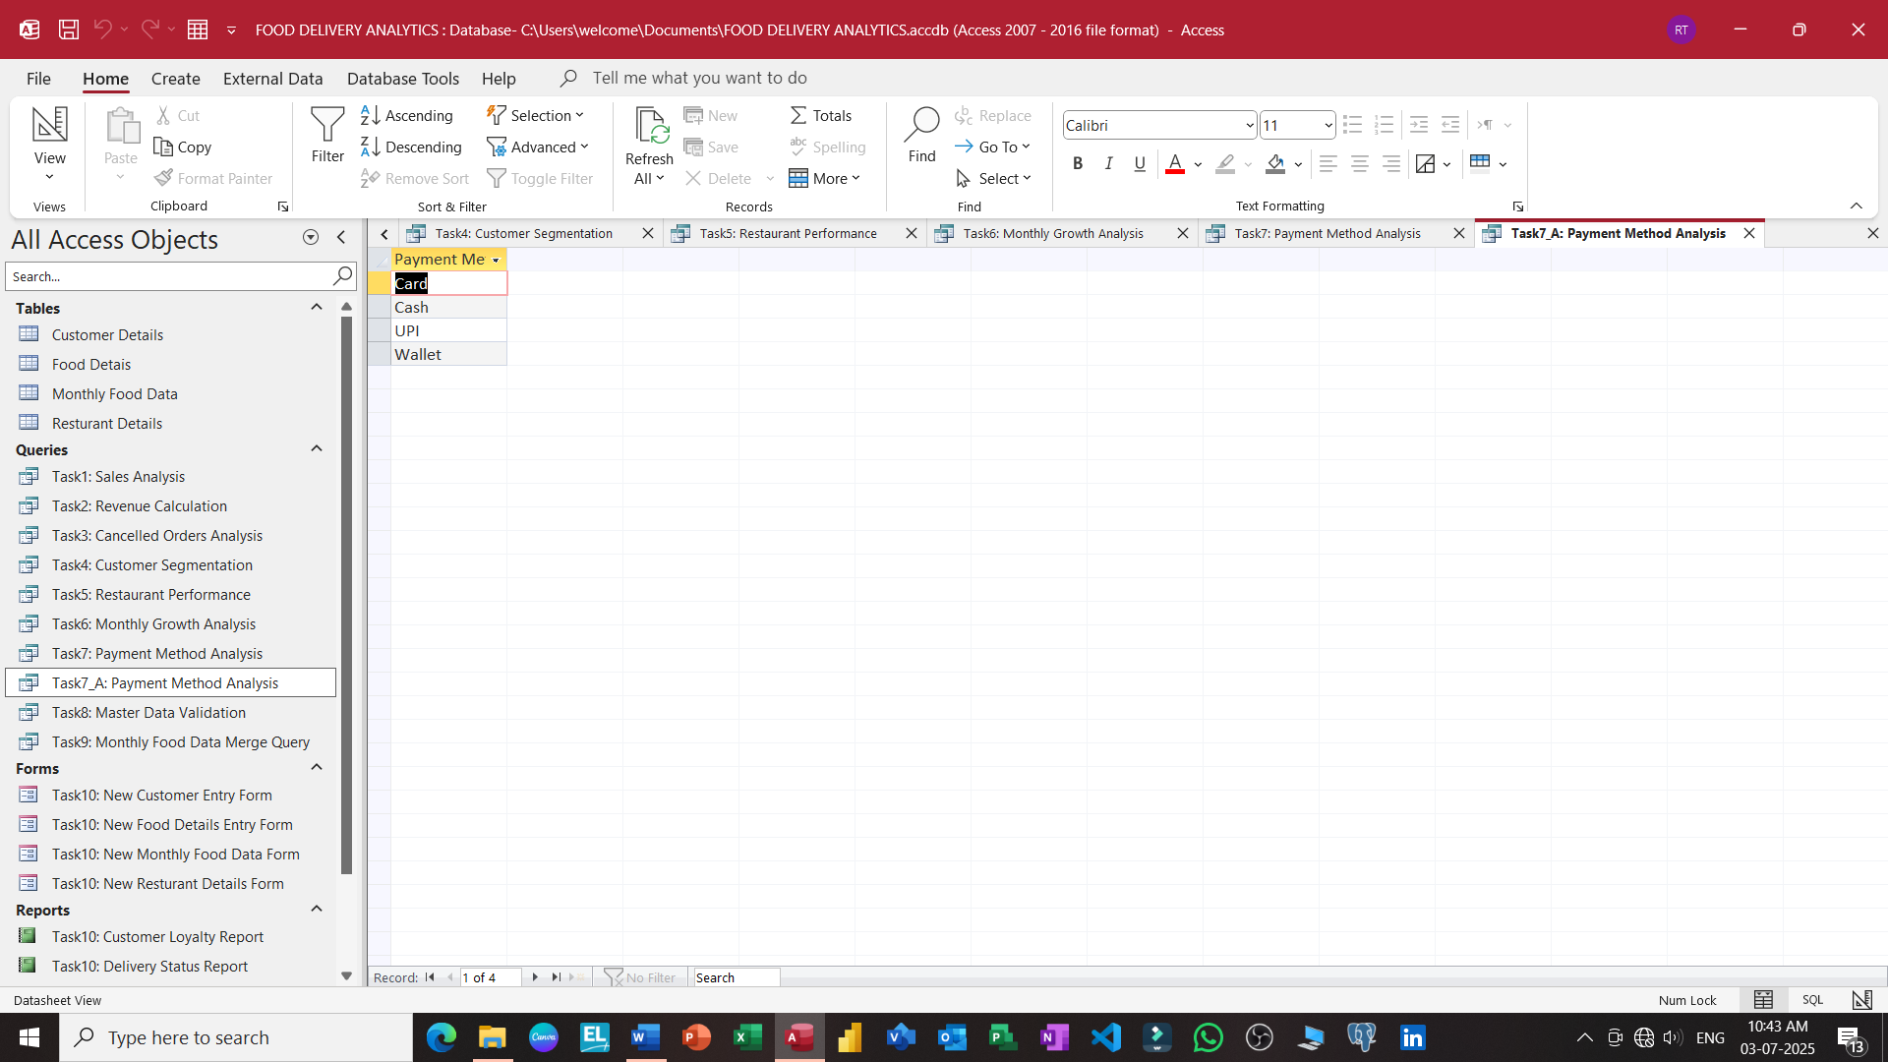

Slide 24
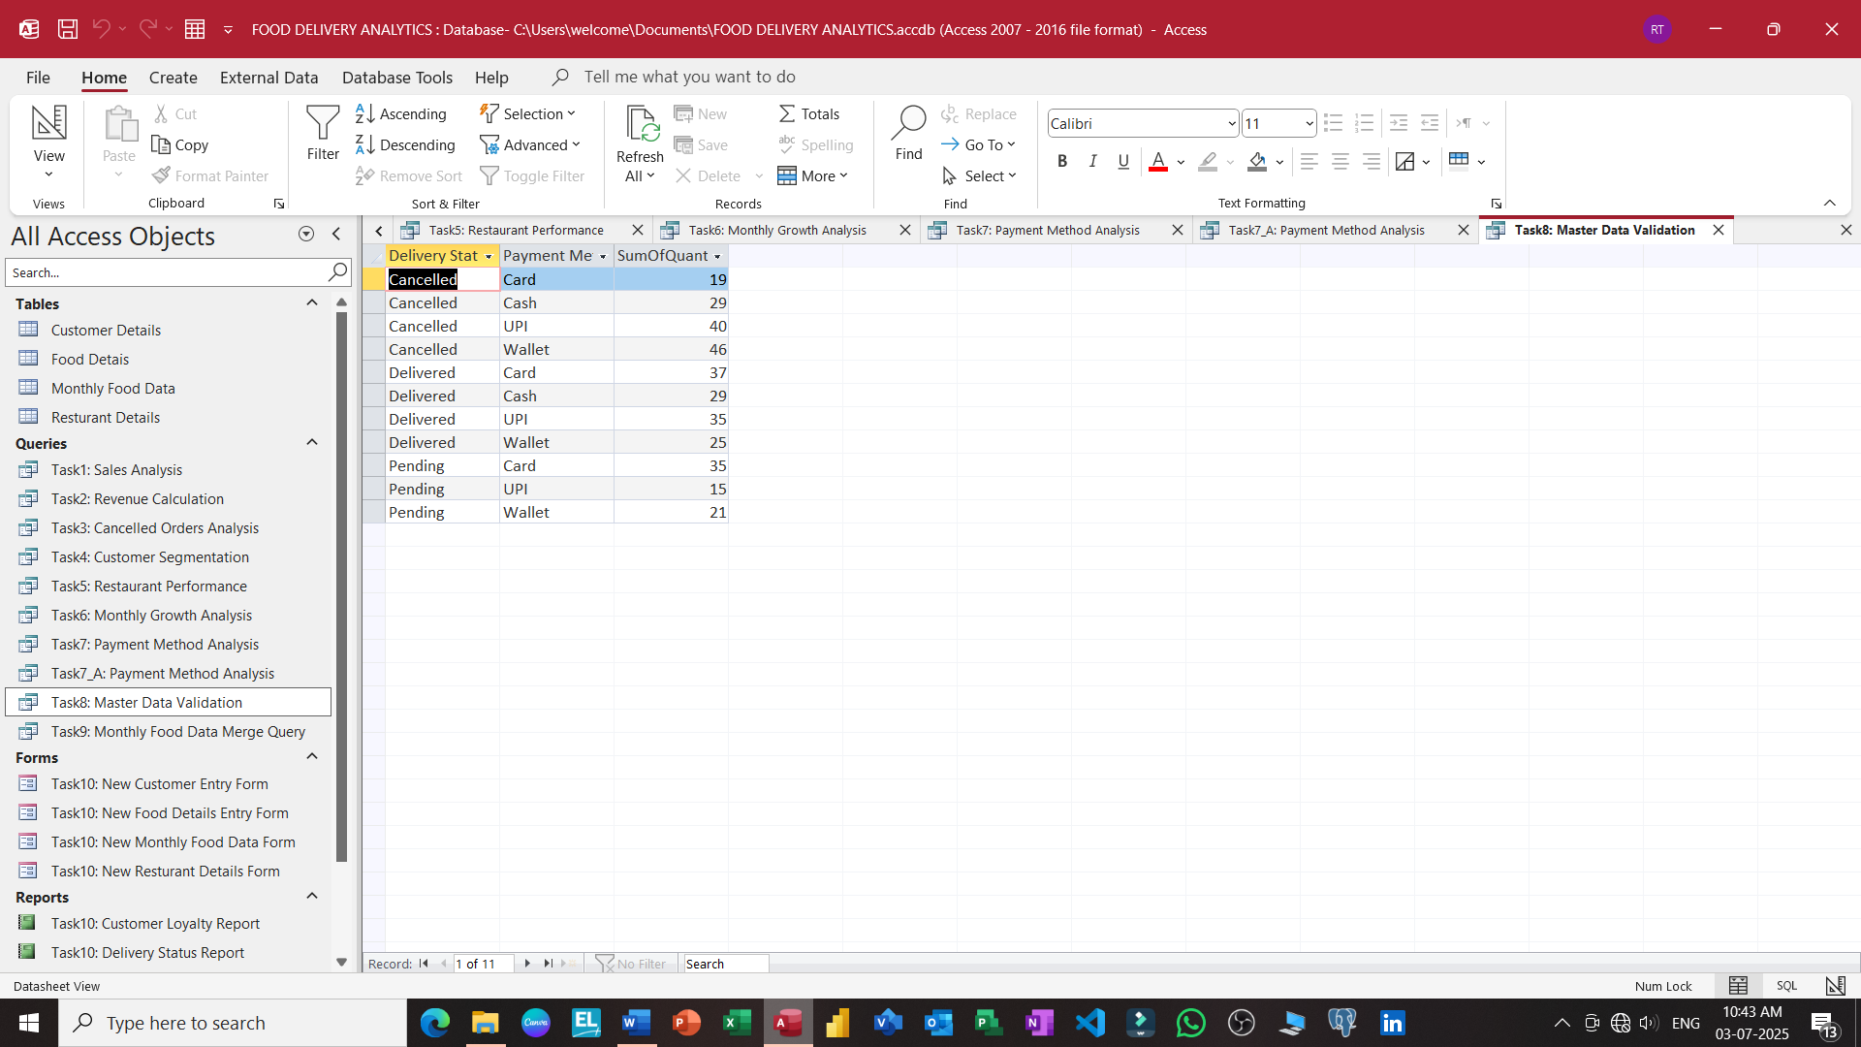

Slide 25
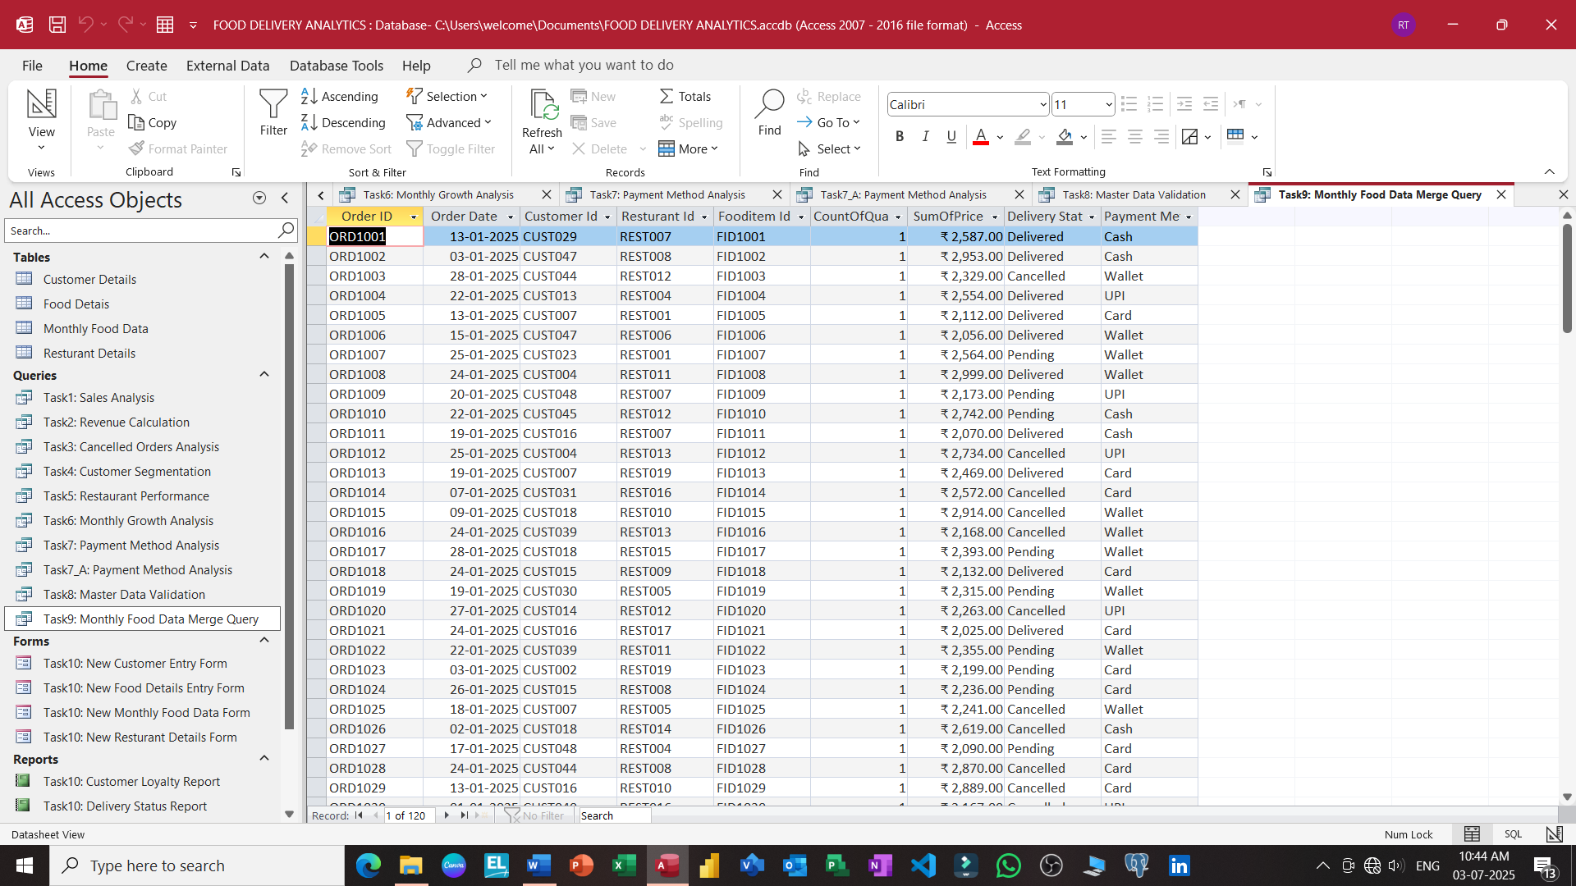

Slide 26
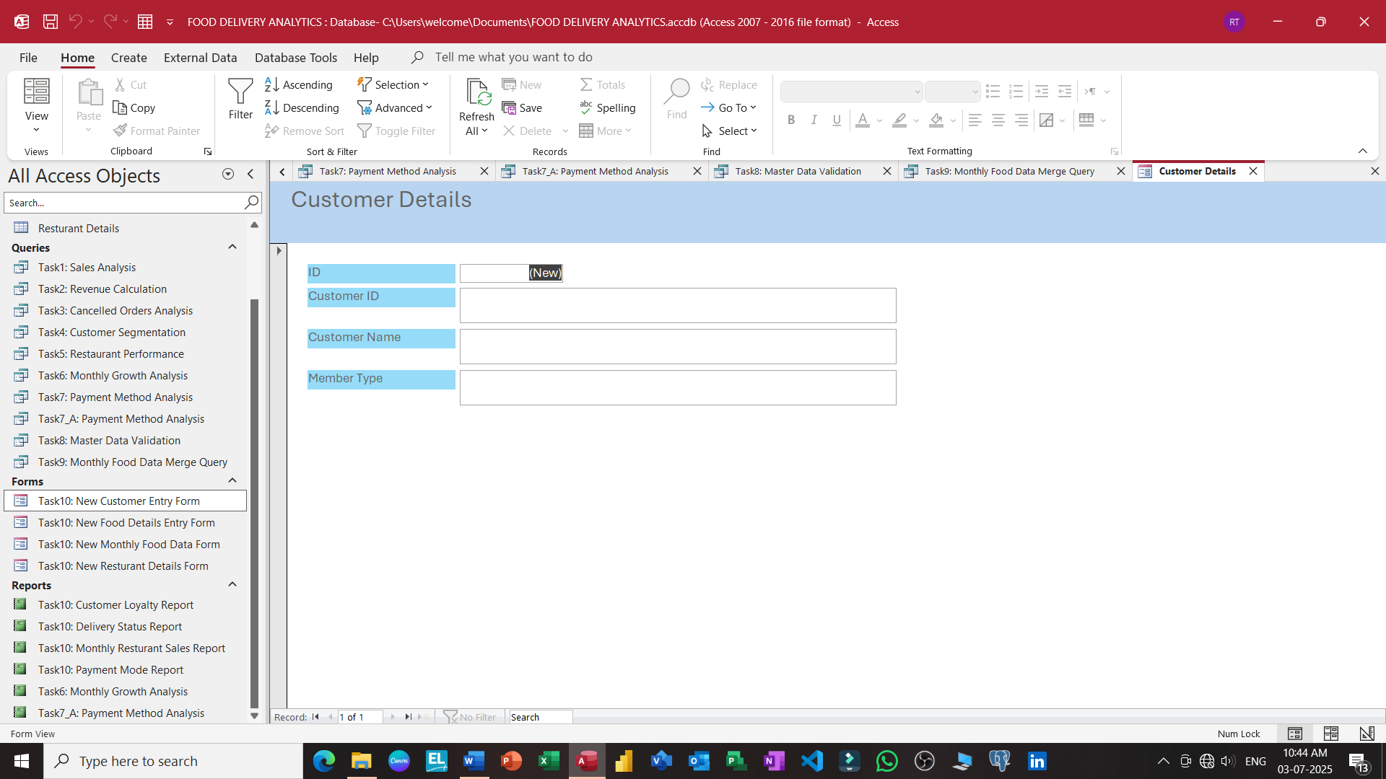

Slide 27
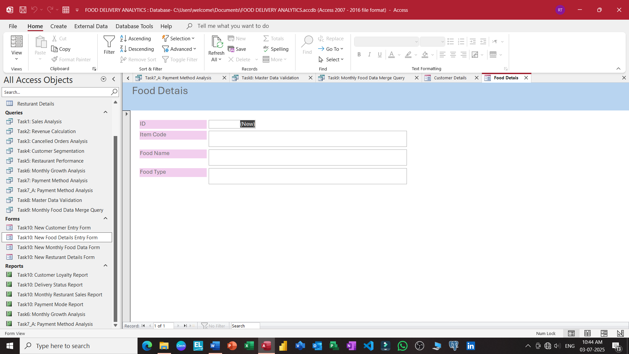

Slide 28
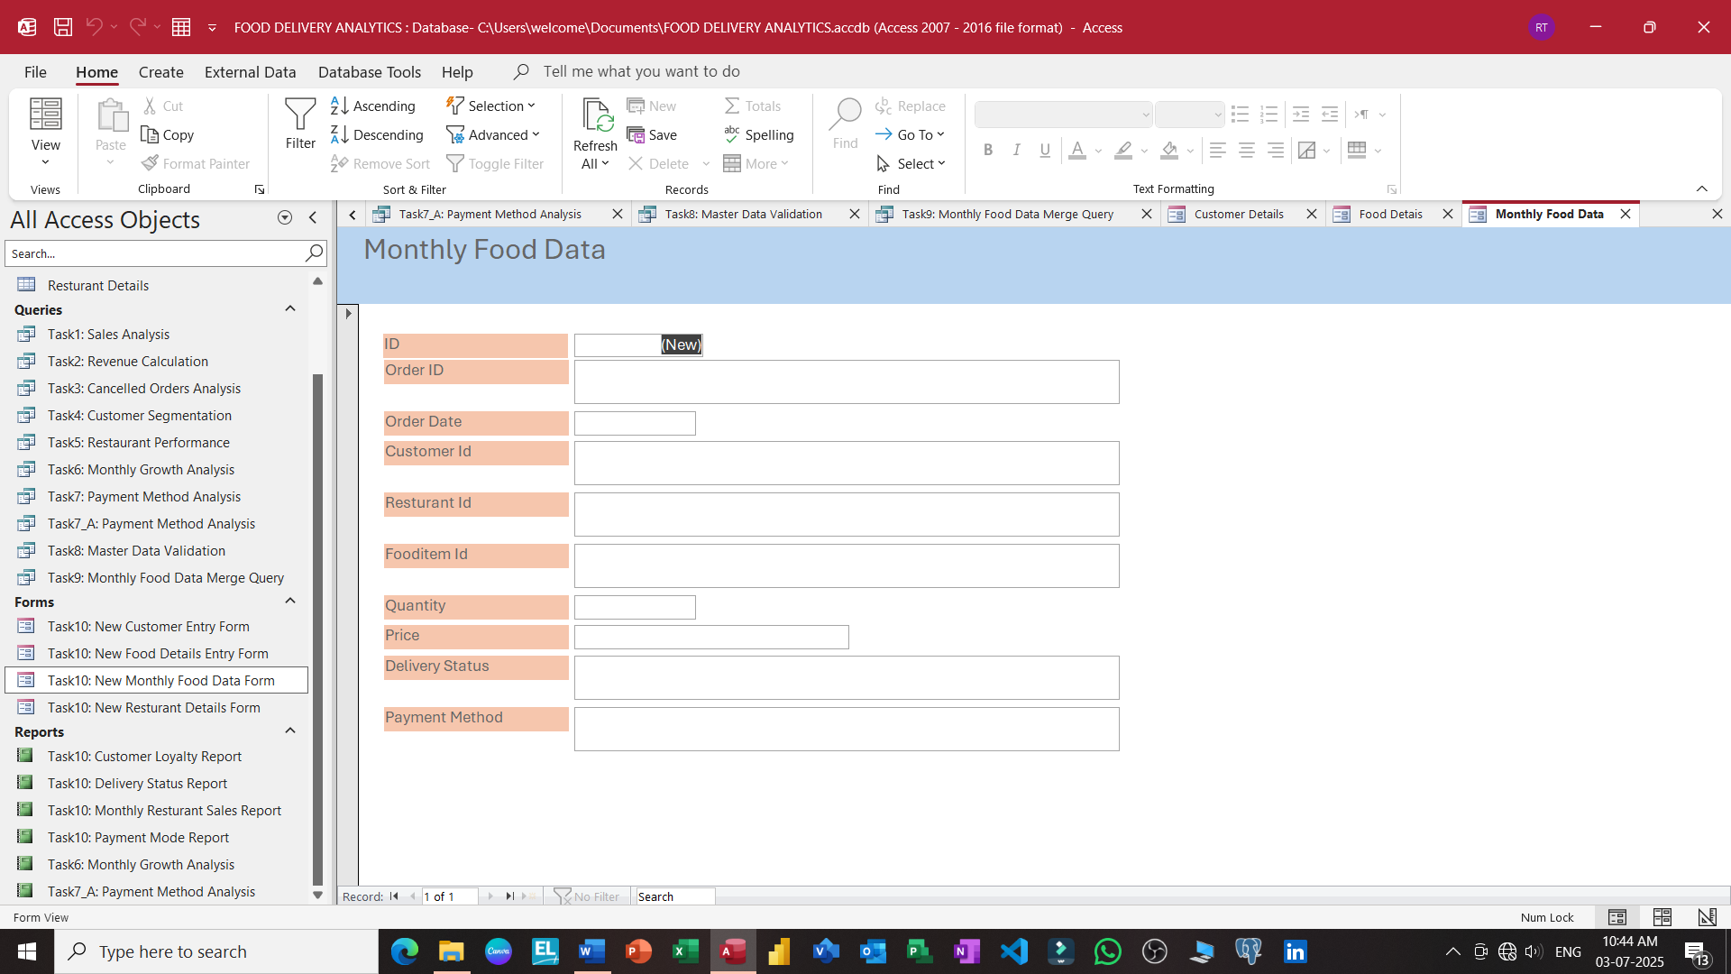

Slide 29
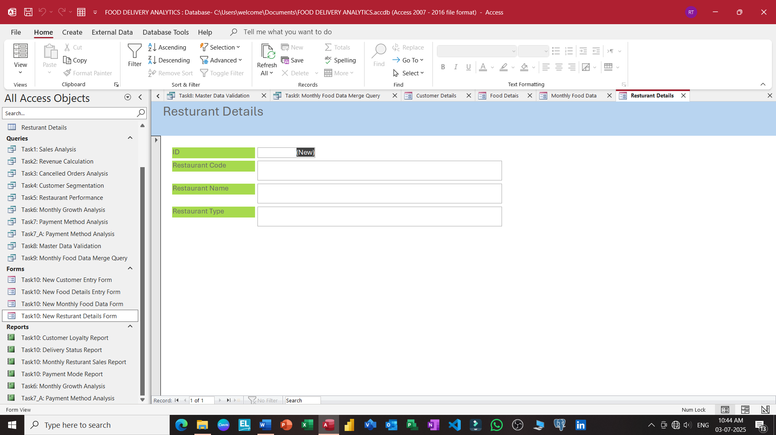

Slide 30
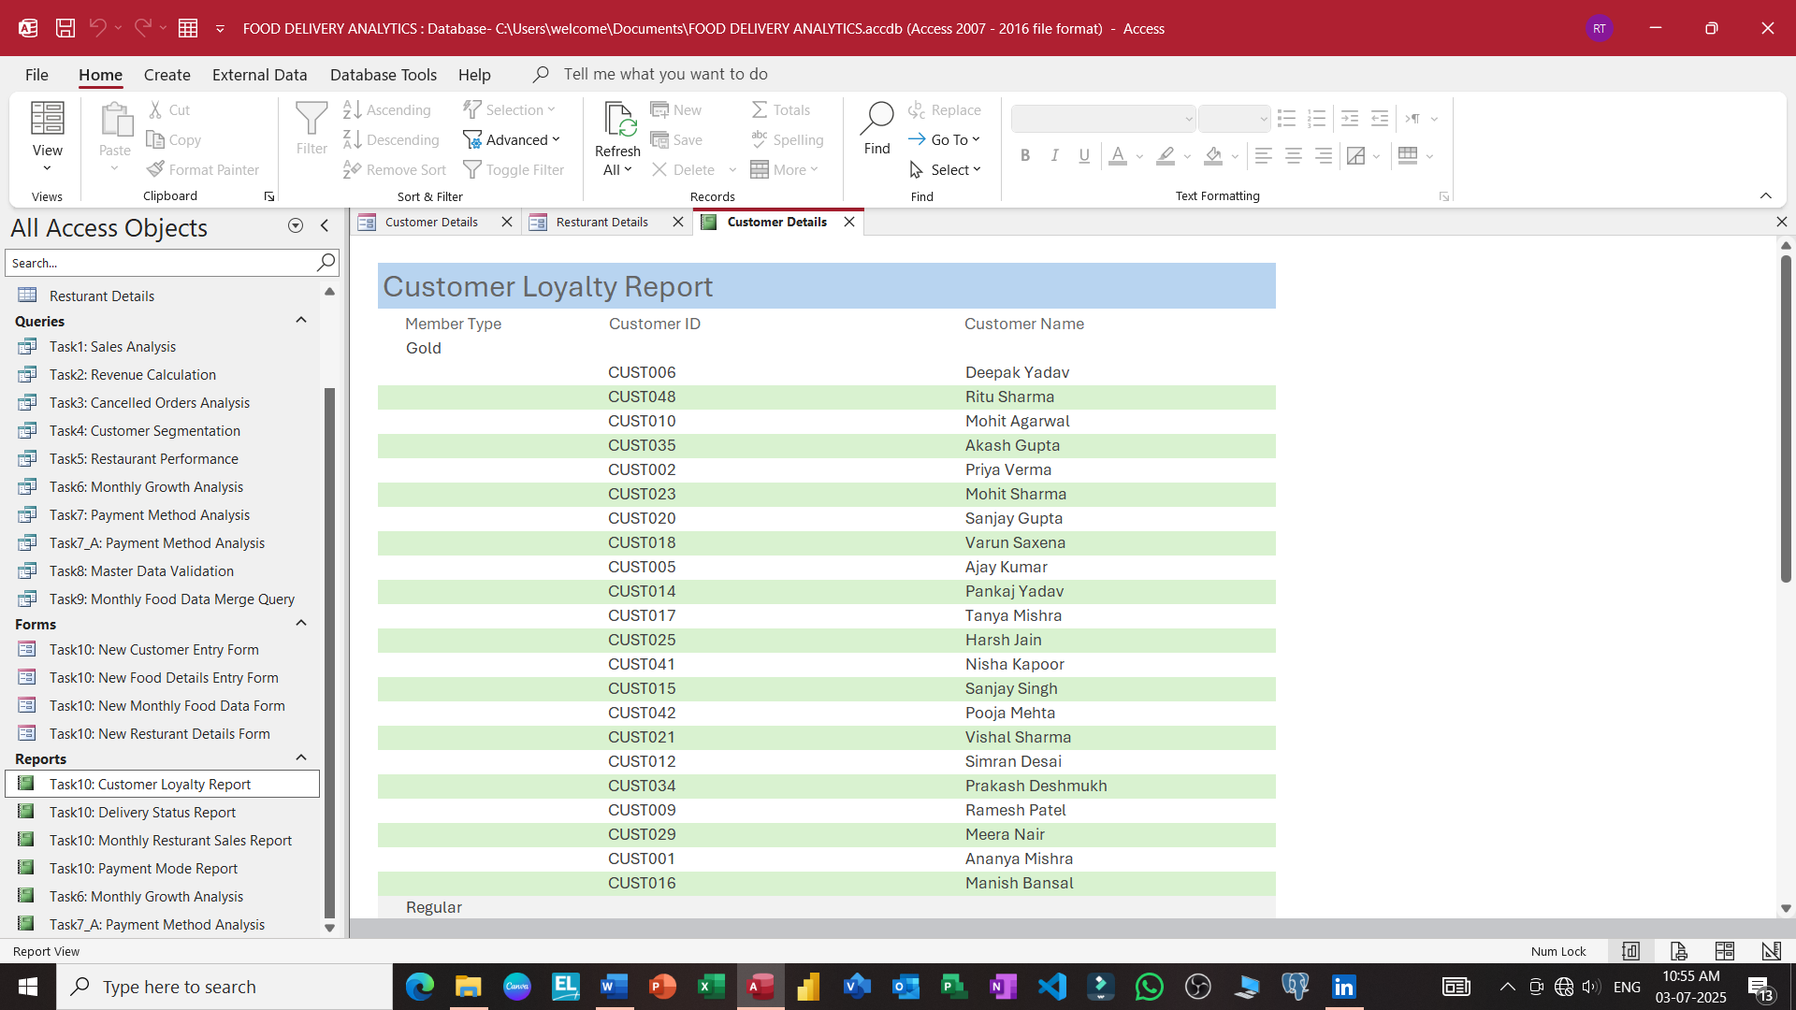

Slide 31
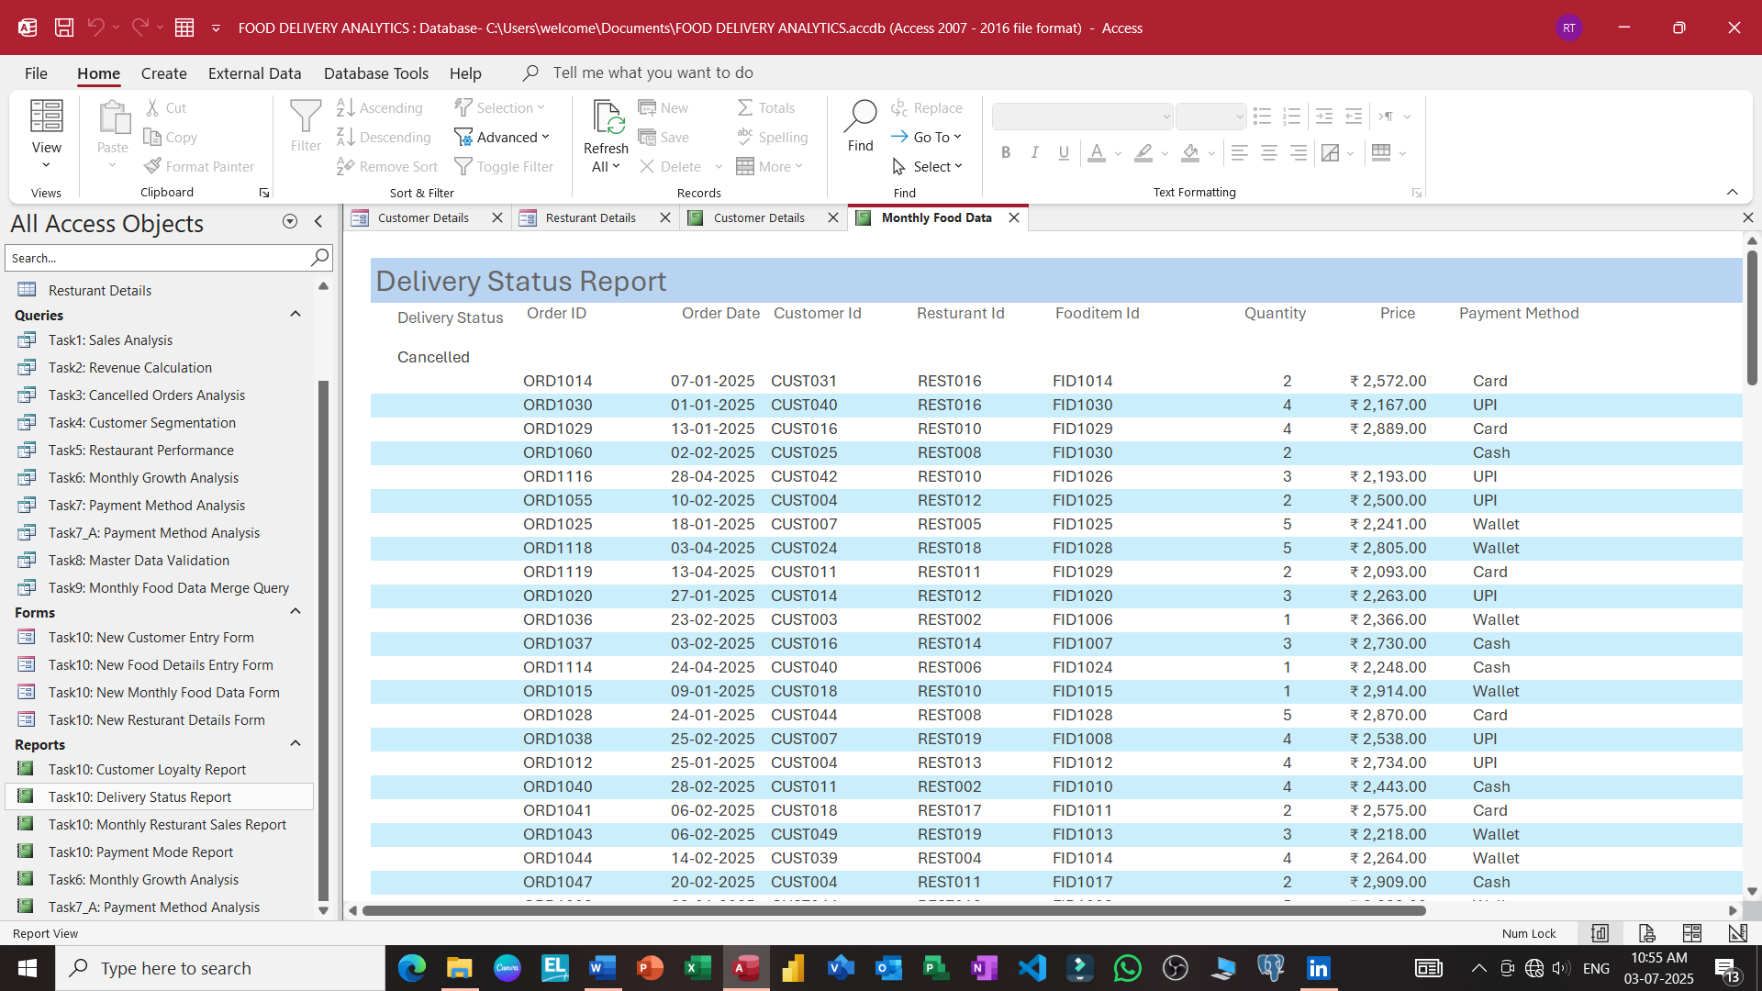

Slide 32
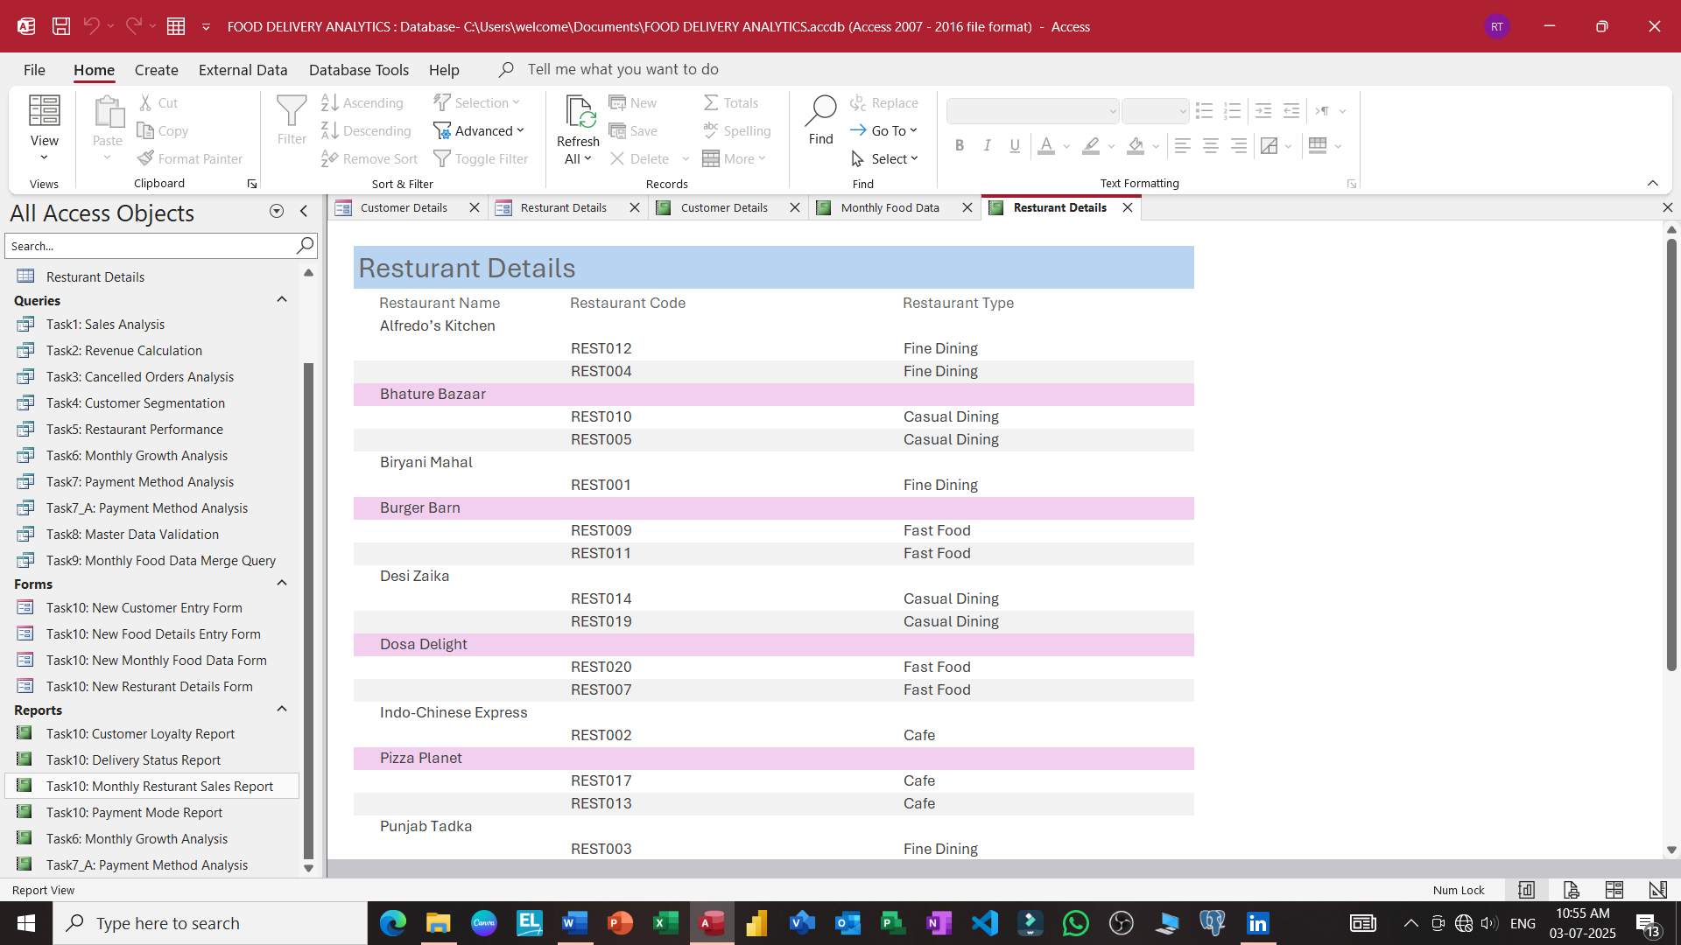

Slide 33
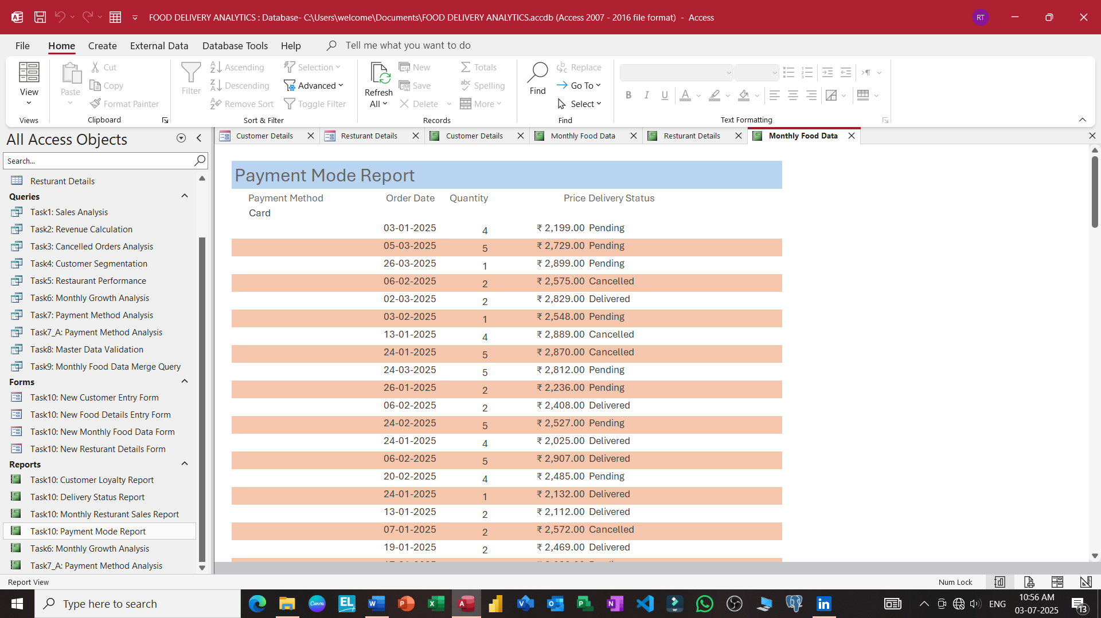

Slide 34
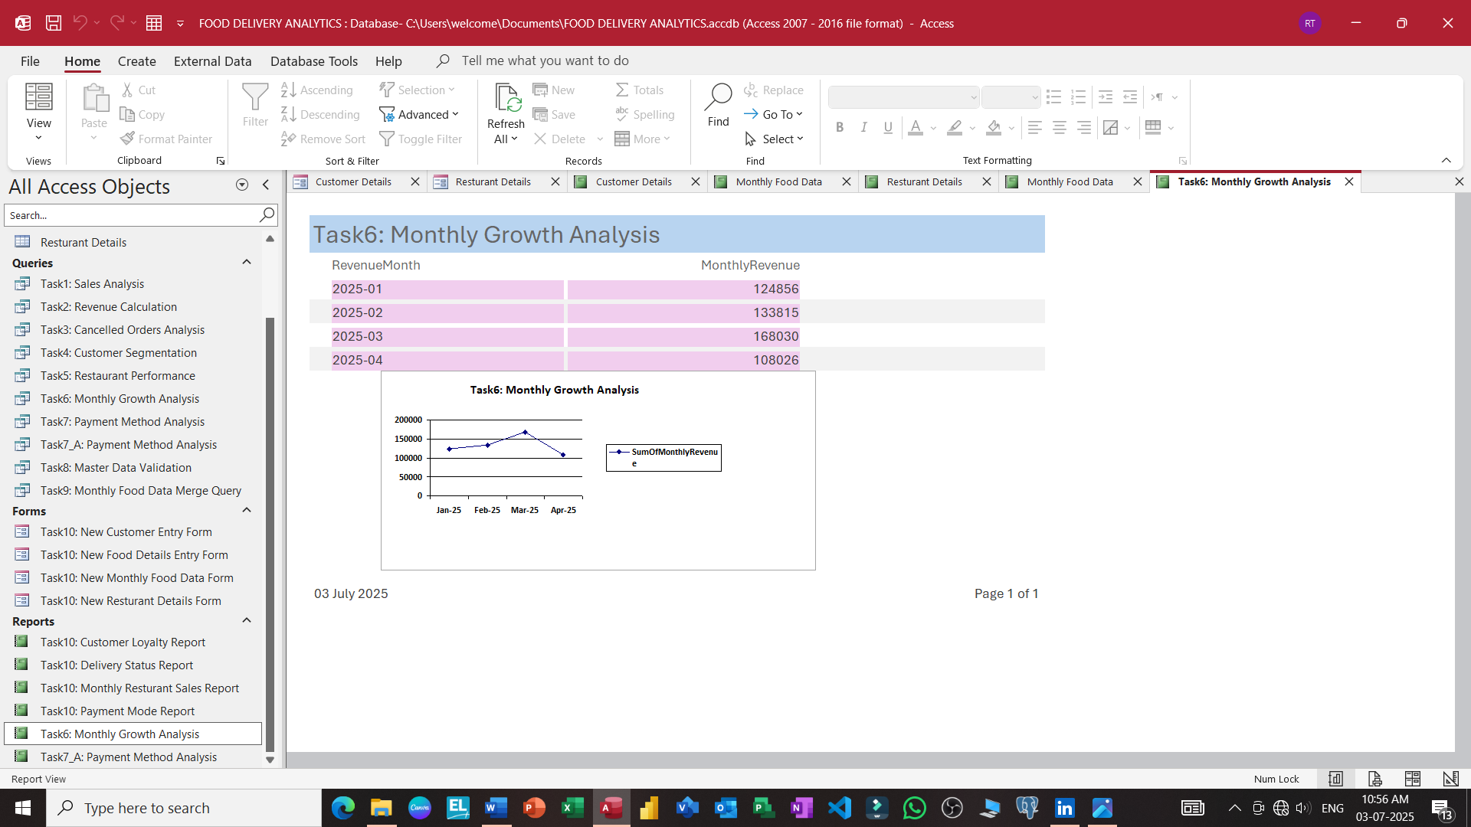

Slide 35
